Slide 1
Variable & operator
Jidesh govinda baidya

Slide 2
variable
A variable is a name given to a storage area that is used to store values of various data types.
Each variable in C# needs to have a specific type, which determines the size and layout of the variable's memory.

Slide 3
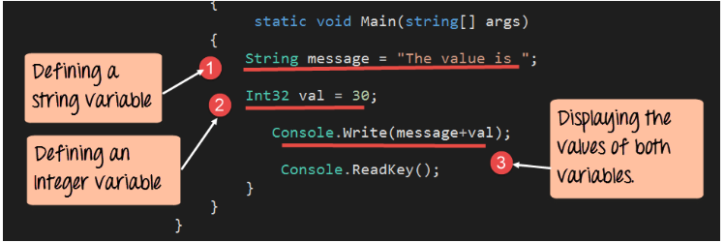

Slide 4
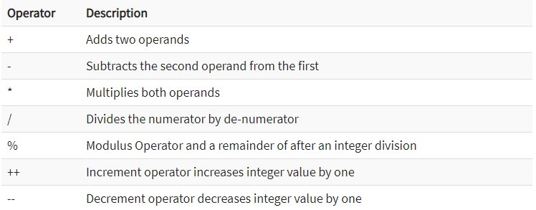
C# operators Arithmetic operator
These are operators used for performing mathematic operations on numbers. Below is the list of operators available in C#.

Slide 5
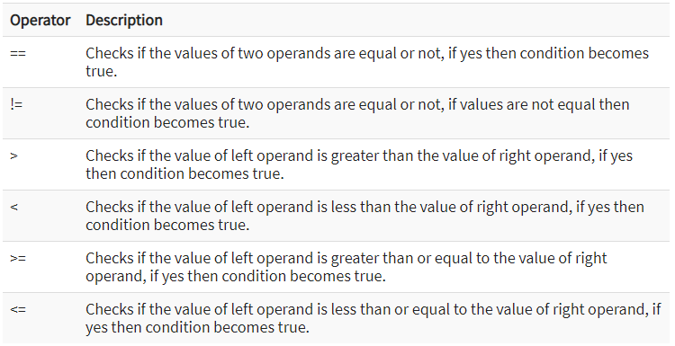
Relational Operators
These are operators used for performing Relational operations on numbers. Below is the list of relational operators available in C#.

Slide 6
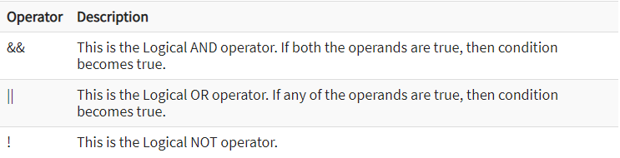
Logical operators
These are operators used for performing Logical operations on values. Below is the list of operators available in C#.

Slide 7
